Slide 1
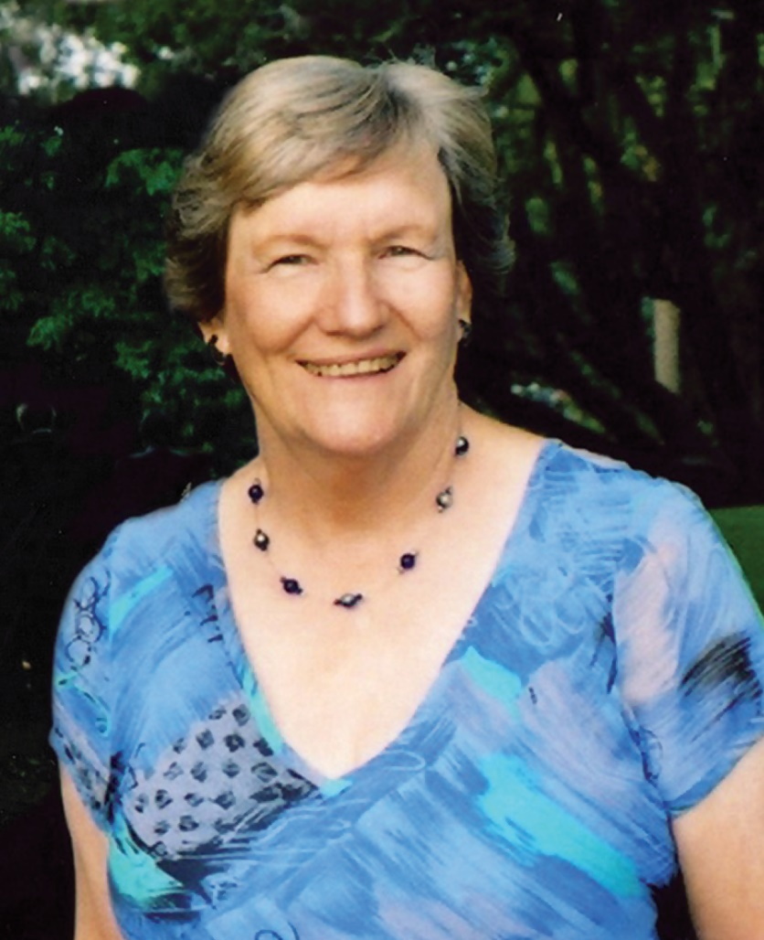
Rosemary Agnew
8 June 1941 – 6 November 2019

Slide 7
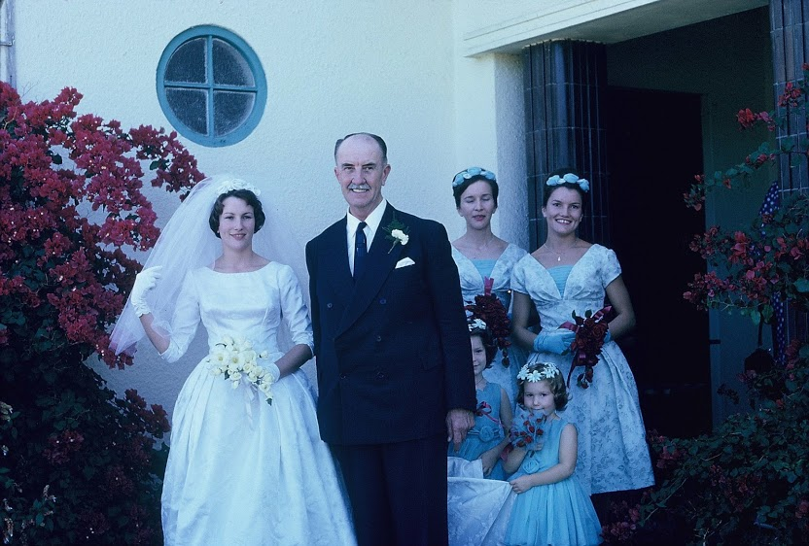

Slide 8
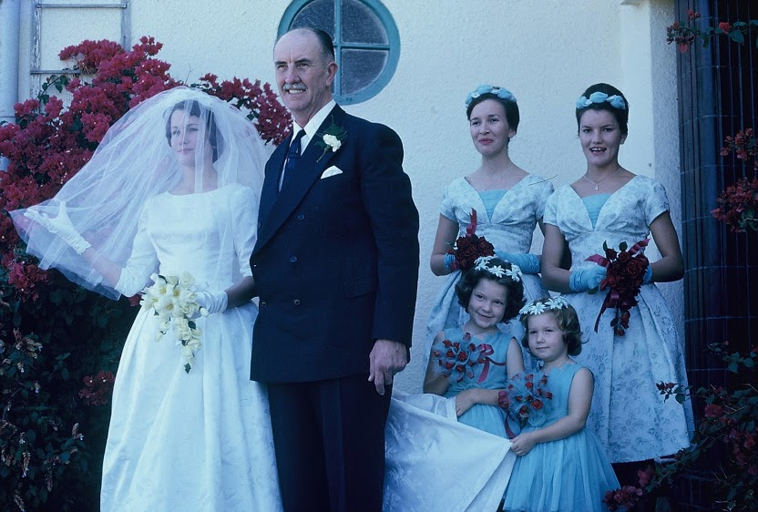

Slide 47
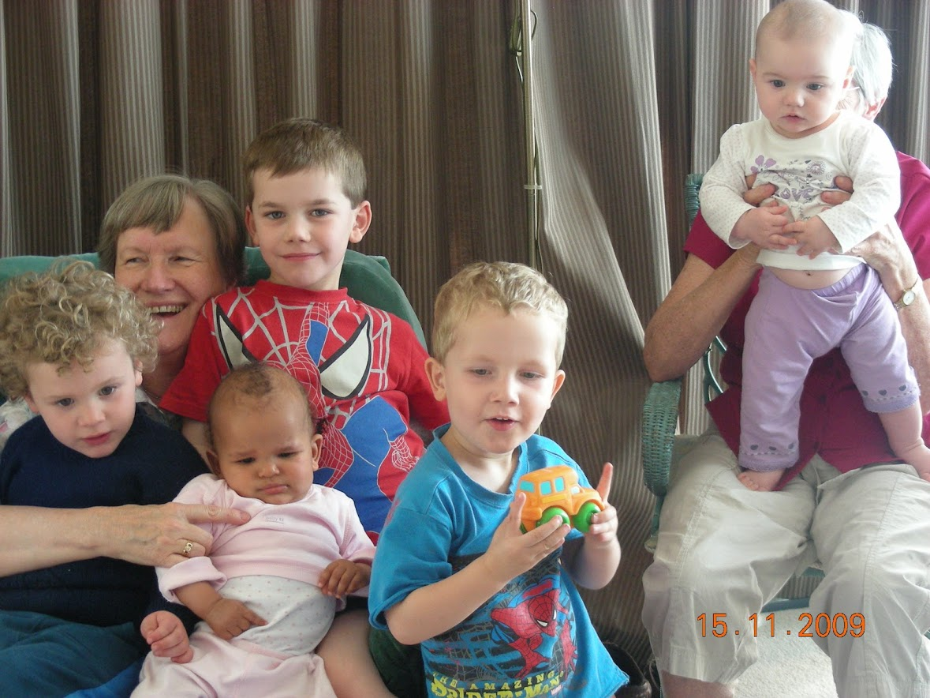

Slide 74
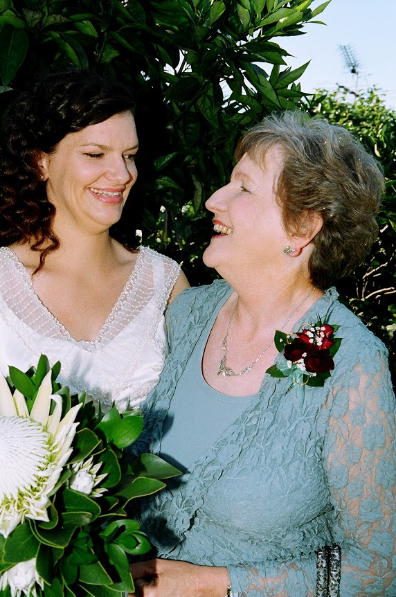

Slide 85
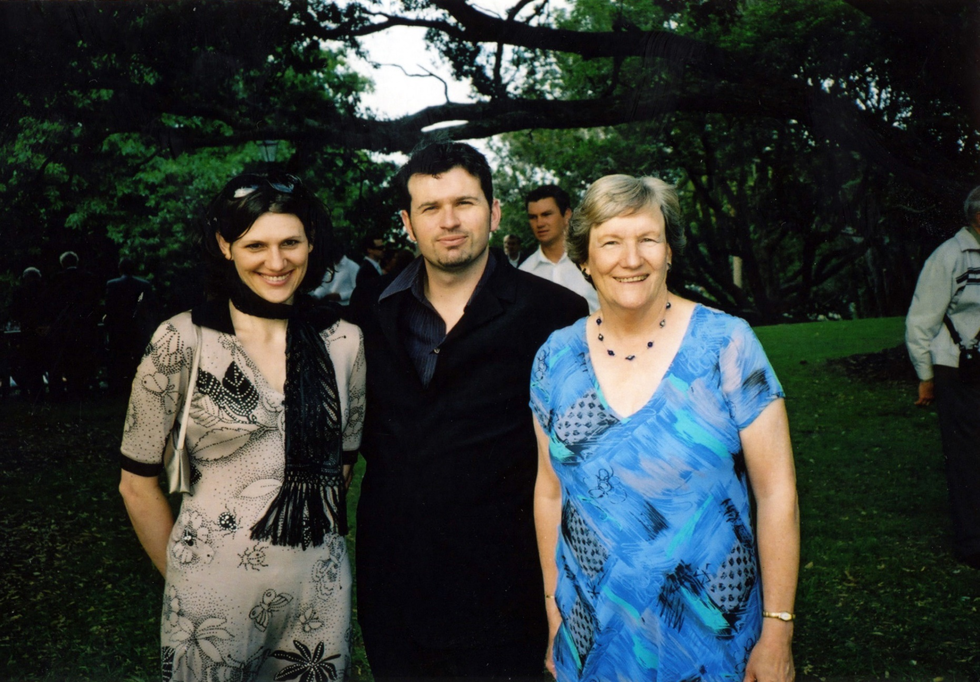

Slide 96
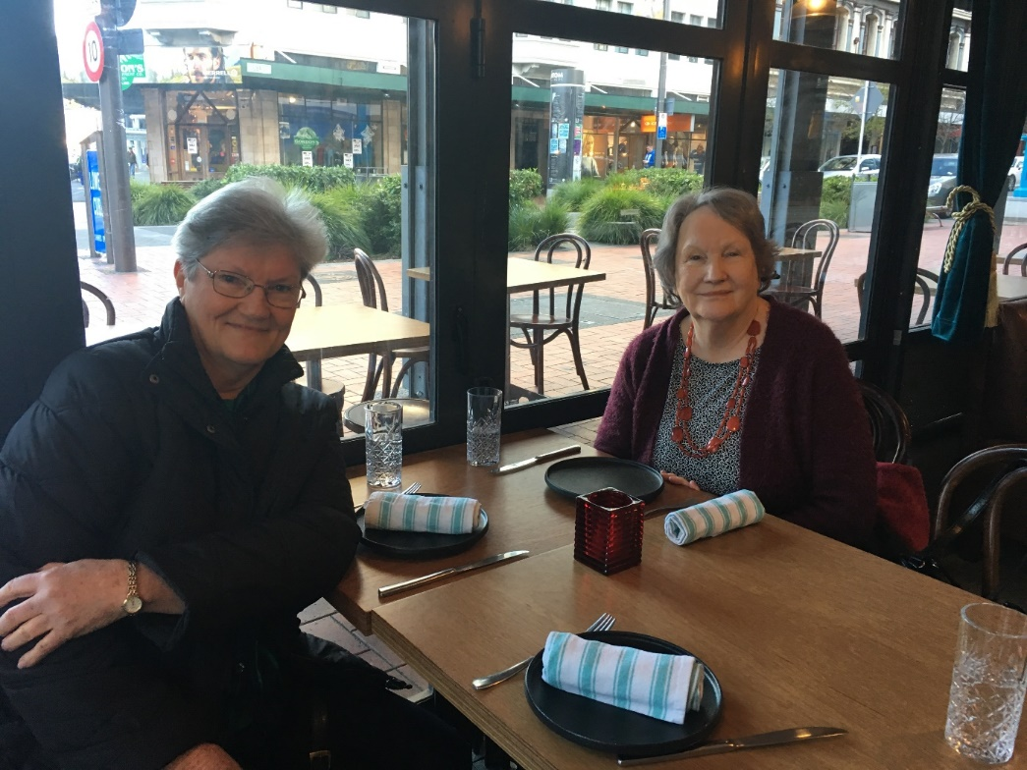

Slide 98
But those who hope in the Lord will renew their strength. They will soar on wings like eagles, they will run and not grow weary, they will walk and not be faint.
Isaiah 40:31

